Slide 1
WOMEN EMPOWERMENT
Gladiator Case Study Presentation
TEAM: SHE-UNIT
SHWETA BHALERAO (TL)
MAYURI SURASE
KOMAL JANWE
ANJALI ROY
Date: 27/11/2019

Slide 2
PROBLEM STATEMENT
To encourage and empower women(single/widow/divorce/married/old women) or girl child(poor/orphan).
Empowering women through any ways either by providing employment opportunity , accommodation , education or finance funds.
Encouraging women’s talent and providing all possible facilities.

Slide 3
OBJECTIVES
Save and conveniently located accommodation for working women.
Day-Care facilities for their childern or elderly people.
Urban/Semi Urban/Rural area where employment opportunity for Women exist.

Slide 4
Abstract
The project is aimed to provide schemes initiated by government of India as an Integrated Package of following services to women are:
Economically more viable in the Society.
Must be independent.
To raise the socio-economic status.
To enable self-dependent. .
This application consist of scheme related to social welfare and financial service for women.
Sukanya Samridhi Yojana:
It provide saving scheme targeted at parent of girl child.
Encourage for future education and marriage expenses. Sukanya Samridhi account will be deposit of minimum amount of Rs.1000(till she turns 10).
Small deposit scheme for girl child as part of ‘BETI BACHAO BETI PADHAO’ campaign.

Slide 5
MAIN AIMs
To provide skill, Employment, Competencies, skills for self employed or Entrepreneur, and Soft skills.
Sectors will be Agriculture, Horticulture, Food processing, Handlooms, Tailoring, Stitching, Embroidery, Handicrafts, Computer/It, Gems & Jewellery.
Eligibility Criteria:
Girl child should be Indian Resident, and if residency status is interim then no interest shall be payable from date of change and account will be closed prematurely.
Girl upto age of 18 years and boy must be age of 5 years may accompany working mother will be provided accomodation.
Working, single, widowed, divorced, seperated , married but her husband or immediate family doesnot reside in same city/area.

Slide 6
FLOW DIAGRAM
START
GET VALIDATED DATA
FETCH DATA FROM
RESPECTIVE TABLE
MVC FOR USER
AND ADMIN
DISPLAY THE DATA
STOP

Slide 7
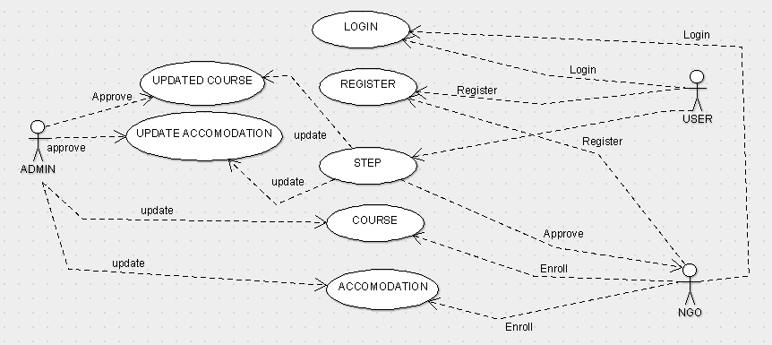
USECASE DIAGRAM

Slide 8
TECHNOLOGIES & TOOL VERSIONS
Spring Framework- version 5.1.3 Release
Spring-Core
Spring-Beans
Spring-Context
Spring-jdbc
Spring-orm
Spring-web
Spring-webmvc
Spring-context-support
OJDBC8-version 19.3.0.0
Junit - version 5.1.3 Release
DBCP2-version 2.7.0
Hibernate-version 5.4.5 Final
Hibernate-core
Mail-version 1.4
Commons-file upload-version 1.4
Servlet-API-version 2.4
JSTL-version1.2

Slide 9
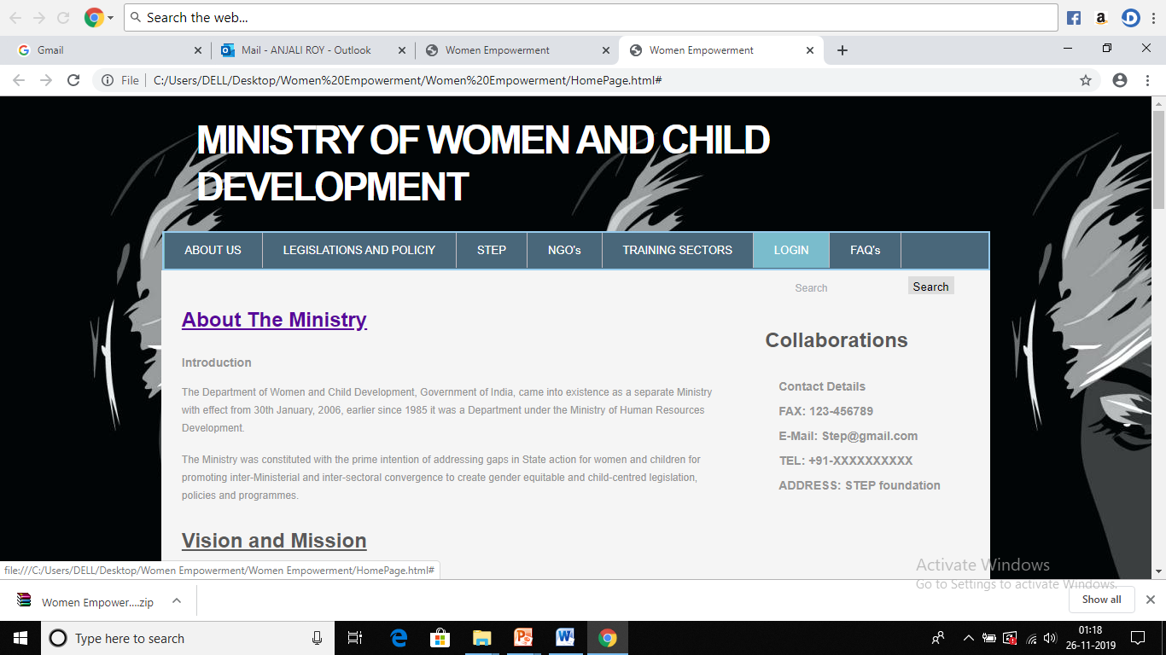
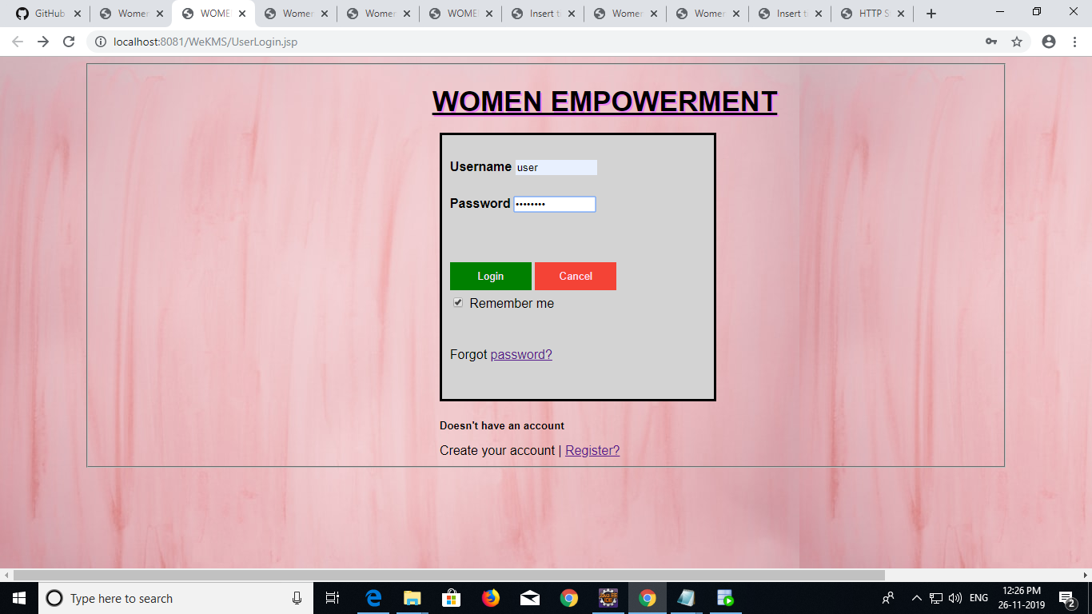
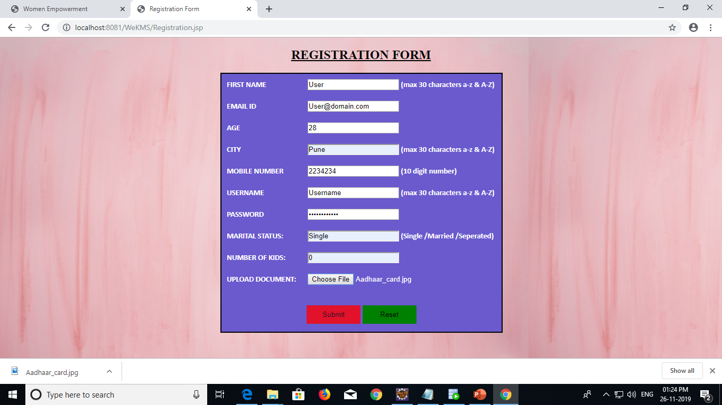
HOME PAGE LAYOUT

Slide 10
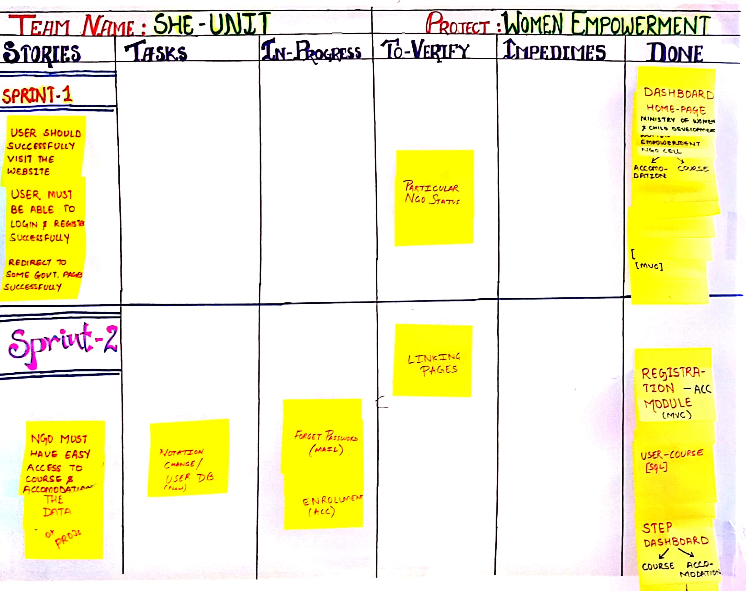
AGILE METHOD (SCRUM BOARD)

Slide 11
FUTURE SCOPE
Empowering one woman means encouraging a house, society and a country to take a step ahead for development.
It’s all about development of our Country as well as for our Society.
To encourage “BETI BACHAO BETI PDHAO” and “SUKANYA SAMRIDHI YOJANA” schemes.

Slide 12
THANK YOU!!
to
Majrul Ansari Sir
Simant Setu Sir

